Slide 1


Optimal Solutions for Occupant Satisfaction in Microgrid Environment
By- Utsav Sharma
218528291

Slide 2
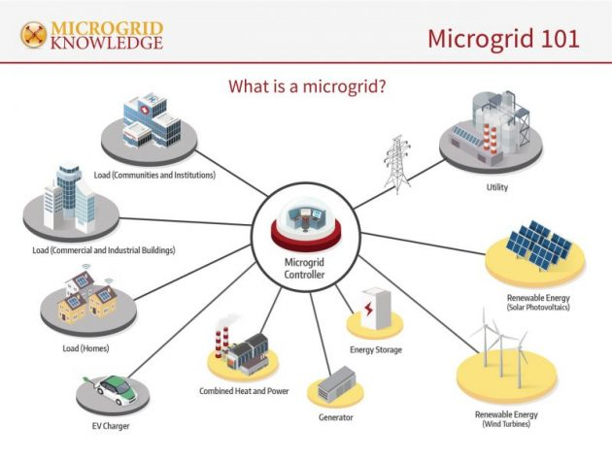
INTRODUCTION
Our aim is to optimally operate a classroom within a Microgrid Environment.
We need to maintain the room temperature in order to achieve thermal comfort level.
Classes take place from 9 am till 8 pm in the evening.
Maintain ideal temperature, have limited number of occupants and not exceed energy consumption limit of the room.
Results have been generated through Regression Analysis and additionally made a small microgrid simulation on Node Red.

Slide 3
TABLE OF CONTENTS
MOTIVATION AND RESEARCH GAPS
PROJECT GOALS
FACTORS AFFECTING OUR GOALS
ARTEFACT DEMONSTRATION AND RESULTS
FUTURE WORK

Slide 4
MOTIVATION AND RESEARCH GAPS
A microgrid is a localized group of electricity sources that generate energy with the help of Renewable Energy Sources (RES) such as Solar Energy Wind Energy and are a reliable backup source of power in times of need.
The microgrid environment is based on Deakin University’s Waurn Ponds campus. Our aim is to operate a classroom, with ‘x’ number of occupants/students.
The room has electrical appliances which ensures the occupant is satisfied in their thermal comfort levels. Thermal comfort is the indoor air temperature, in which the individual feels comfortable. Thermal comfort is found in cold conditions and the temperature lies between 20-24 degrees
The microgrid environment must generate energy to run these appliances. The energy consumption increases with increase in number of occupant’s room.
There aren’t any research papers discussing the factors affecting an occupant’s thermal comfort. My paper identifies these factors and correlations between these factors.

Slide 5
PROJECT GOALS
Maintain Ideal Temperature in the classroom
Preferably between 20-24 degrees
Do not exceed energy consumption and energy cost limits
Don’t consume more that 1 kWh energy per class
Classroom size- 2000 square feet. Appliances- HVAC system, Light Fixtures, Projector and additional plug loads.
Establish the ideal number of occupants in the class

Slide 6
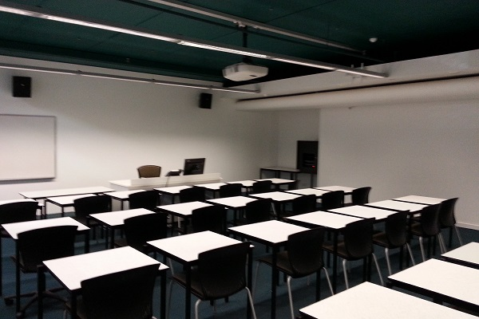
FACTORS CORRELATIONS AFFECTING OUR GOALS
Room Temperature
Number of Occupants
Relative Humidity
Outside Temperature
Solar Irradiance
Energy Consumption
HVAC Consumption
Light Fixtures Consumption
Additional Equipment Consumptions

Slide 7
MAINTAIN AND IDEAL TEMPERATURE IN THE ROOM
Number of Occupants
Relative Humidity
Outside Temperature
HVAC Consumption
Number of occupants increase --→ Relative Humidity increases as well.
This leads to an increase in room temperature. The Air Conditioner is used to reduce the temperature
Use of Air Conditioner -→ High Energy Consumption
The number of occupants are correlated to both of our goals

Slide 8
DON’T EXCEED ENERGY CONSUMPTION AND ENERGY COST LIMIT
HVAC Consumption
Light Fixtures Consumption
Solar Irradiance
Additional Equipment Consumptions
HVAC is used throughout the day. It has a high energy consumption amount. It’s the only source that can reduce the room temperature
The light fixtures and additional equipment loads don’t consume much energy when compared to the HVAC Consumption
Solar irradiance is more of a factor for light fixtures.
Additional Equipment Loads depends on the number of occupants

Slide 9
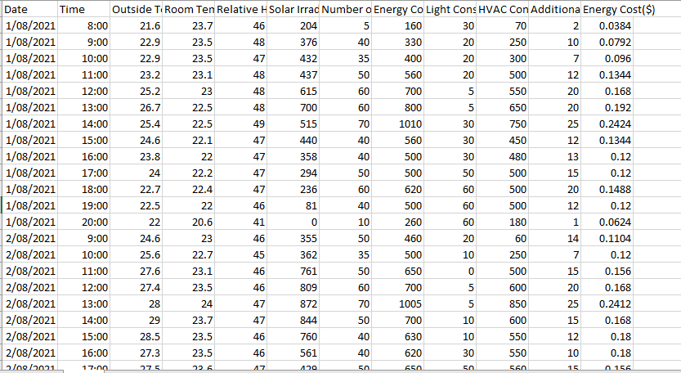
ARTEFACT DATA COLLECTION
Data Collection is a vital part of my artefacts. Quantitative data procedures was carried out for both artefacts.
The datasets contain outside temperature, relative humidity, room temperature, energy consumption, solar irradiance and more.
OpenWeatherMap API is used to collect the weather forecast of Waurn Pond. Solar irradiance data is collected using Solcast Toolkit API. Both these columns are used for both artefacts.
The room temperature and relative humidity values were found in an online database.
The HVAC, Light and Additional Equipment consumption values were researched thoroughly.

Slide 10
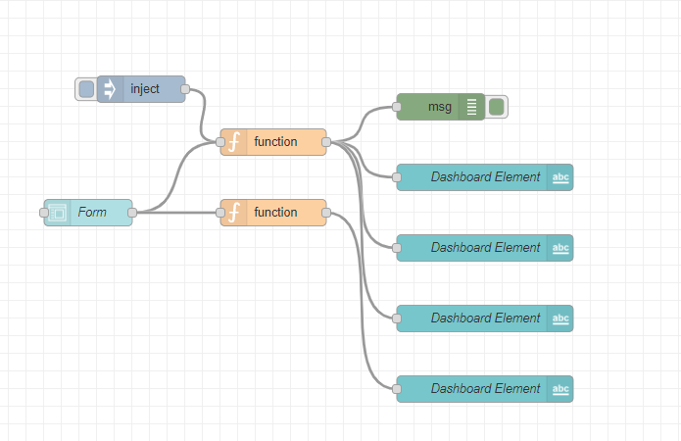
NODE RED SIMULATION
My first major artefact consists of a Microgrid Simulation developed on Node Red. I used Node Dashboard UI module.
The simulation calculates the total energy generation in a microgrid system.
The Node Red flows begins with the Inject Node and ends with the Debug Node.
The Form node implements each of our inputs and the Function Node contains the formulas used. The text input node named Dashboard implements the results board for our simulation.
Inputs for microgrid simulation are Solar Irradiation, Load demand and solar panels dimensions.
Firstly, calculated the energy efficiency of the solar panel by dividing the solar panel’s maximum charge capacity by its area.

Slide 11
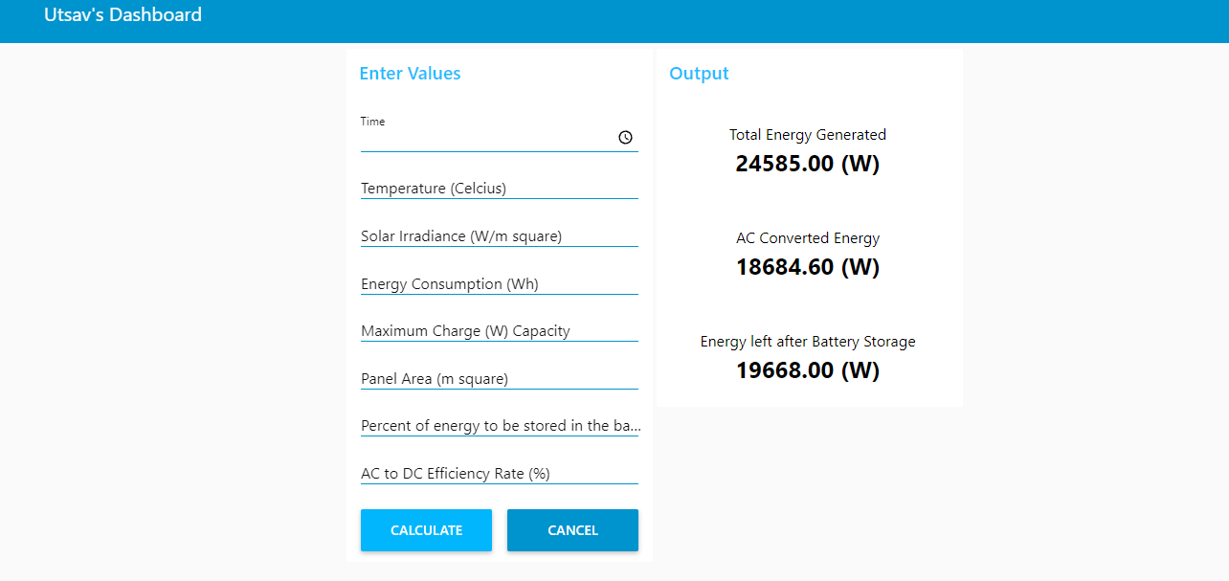
NODE RED SIMULATION
Calculate total energy generation = Solar panel area * Energy Efficiency * Solar Irradiance. The energy generated is DC Source.
Convert DC Source to AC Source = Energy *
Battery Storage- Store 20% of energy generated. Storing batteries is top priority. The batteries are required when there simply isn’t any energy generation
Lastly, supply energy to consumers. Check the load demand and store any excess energy left.
In the simulation, data has been used from datasets. The Dashboard Module makes the simulation more fun and interactive to work on.

Slide 12
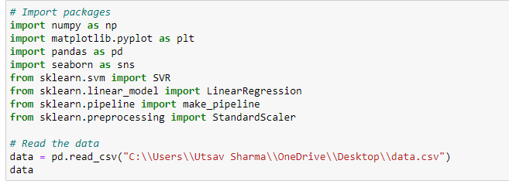
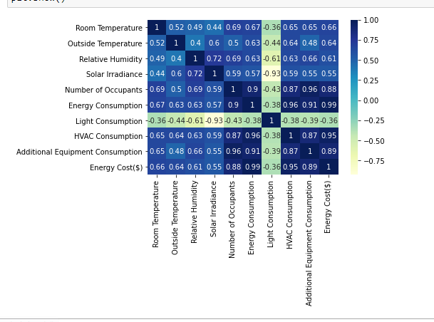
REGRESSION ANALYSIS
The main artefact is the Regression Analysis.
Coded python scripts on Jupyter Notebook to acquire the results. SVM and Linear regression machine learning algorithms were used.
Firstly, read the main dataset file into the notebook and imported the required packages. Then tested a bunch of basic commands.
The next step was to visualise our data and generated a heatmap of the data. The heatmap suggests the room temperature is the most correlated to the number of occupants in the class.

Slide 13
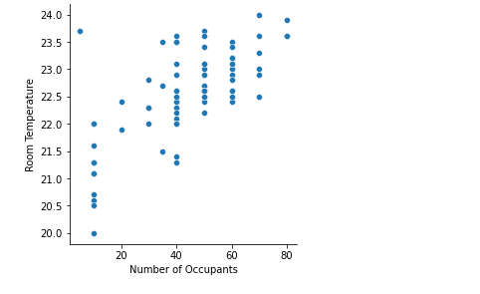
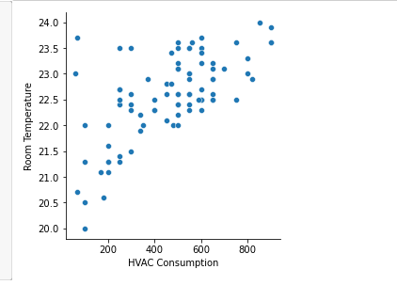
REGRESSION ANALYSIS- GOAL 1
Graphs were generated with the Room Temperature as the Dependent Variable and Outside Temperature, Relative Humidity, Number of occupants and HVAC Consumption as the independent variables.
The graphs indicate that when the Outside Temperature, Relative Humidity and Number of occupants increase, the room temperature increase as well.
When the room temperature is high, the HVAC consumption increases.
A graph between Number of occupants and Relative humidity was generated to prove that when occupants increase the relative humidity increases as well.

Slide 14
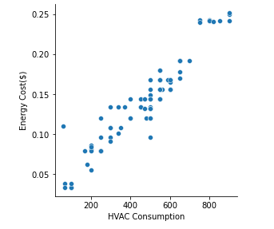
REGRESSION ANALYSIS- GOAL 2
Two sets of graphs were generated with Energy Consumption and Energy Cost as dependent variable and HVAC Consumption, Light Fixtures Consumption, Additional Equipment Consumption as the independent variables.
HVAC determines the total energy consumption.
Light Fixtures is more correlated to the solar irradiance data.
Additional equipment load is correlated to the number of occupants.

Slide 15
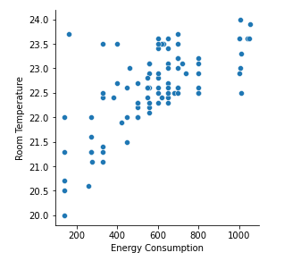
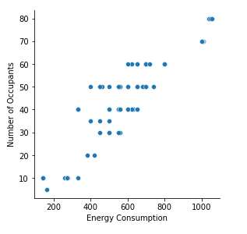
FINAL RESULTS
Graphs between Room Temperature, Energy Consumption and Number of Occupants were generated.
The results obtained were as expected.
When the room temperature increases the energy consumption increases and the when the number of occupants increases the energy consumption increases again.
The class shouldn’t allow more than 60 occupants in a class. In an ideal situation, no more than 30 students should be allowed in the classroom.

Slide 16

FUTURE WORK
Several aspects of a microgrid still require further research and investigation.
Microgrid simulation is the best way to look for viable solutions for microgrids.
Research gaps in microgrid energy generation in unfavourable weather conditions still requires more work to solve.
For my regression analysis, I wasn’t able to acquire actual sensor reading for the room temperature and relative humidity of a classroom with some number of occupants. The graphs still aren’t conclusive enough.

Slide 17
THANK YOU

